Slide 1

Visio 2010 Tips and Techniques
Bring Your Ideas to Life 6/14/2012
This tips & tricks session is being broadcasted Voice over IP (VOIP). Dial phone number is not available so your computer speakers must be turned on. Thank you and enjoy the session☺
Matthew Roderman
CEO/Founder
Tips & Techniques, L.L.C
Tipsandtechniquesnow.com
http://tipsandtechniques.myvbookstore.com
Matthewr@tipsandtechniquesnow.com

Slide 2
Agenda
New Visio User Interface (Ribbon)
New productivity features to Visio 2010
Quick shapes
Auto Align and Spacing
Containers
Process validation
Sub process
SharePoint designer integration
Linking Data from SharePoint foundation list
Shape data and linking data to Visio shapes
Creating data graphics & legends
Data reporting
Creating Timelines & Project Integration
Visio services and SharePoint 2010

Slide 3
DEMO
Visio 2010 Tips & Techniques

Slide 4






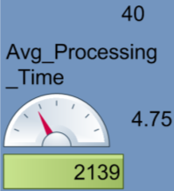

Understanding Visio Services
Data Consumer
Views data-linked diagram in web browser
Can open the diagram in Visio
Publish “VDW” file to SharePoint Server 2010
Data Consumer
Updates Data Graphics by clicking refresh button
Data refresh can be automated by setting interval time
Import latest data to update Data Graphics
Content Creator
Create Data-linked Diagram just as in Visio 2007
Data Source
Excel Services
SharePoint Service List
SQL Server
OLEDB / ODBC

Slide 5
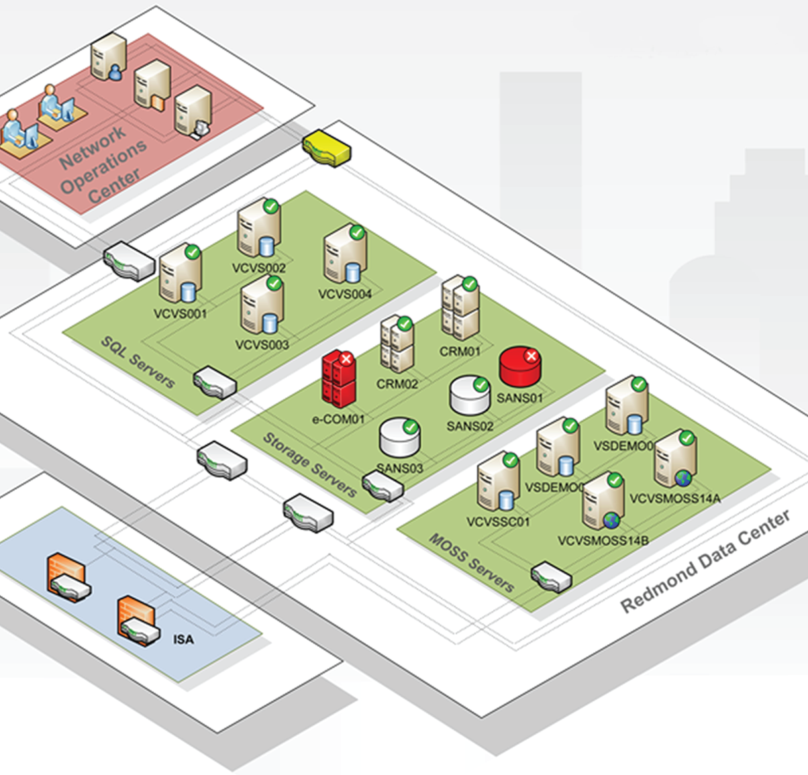
Example: Visio services for IT

Slide 6
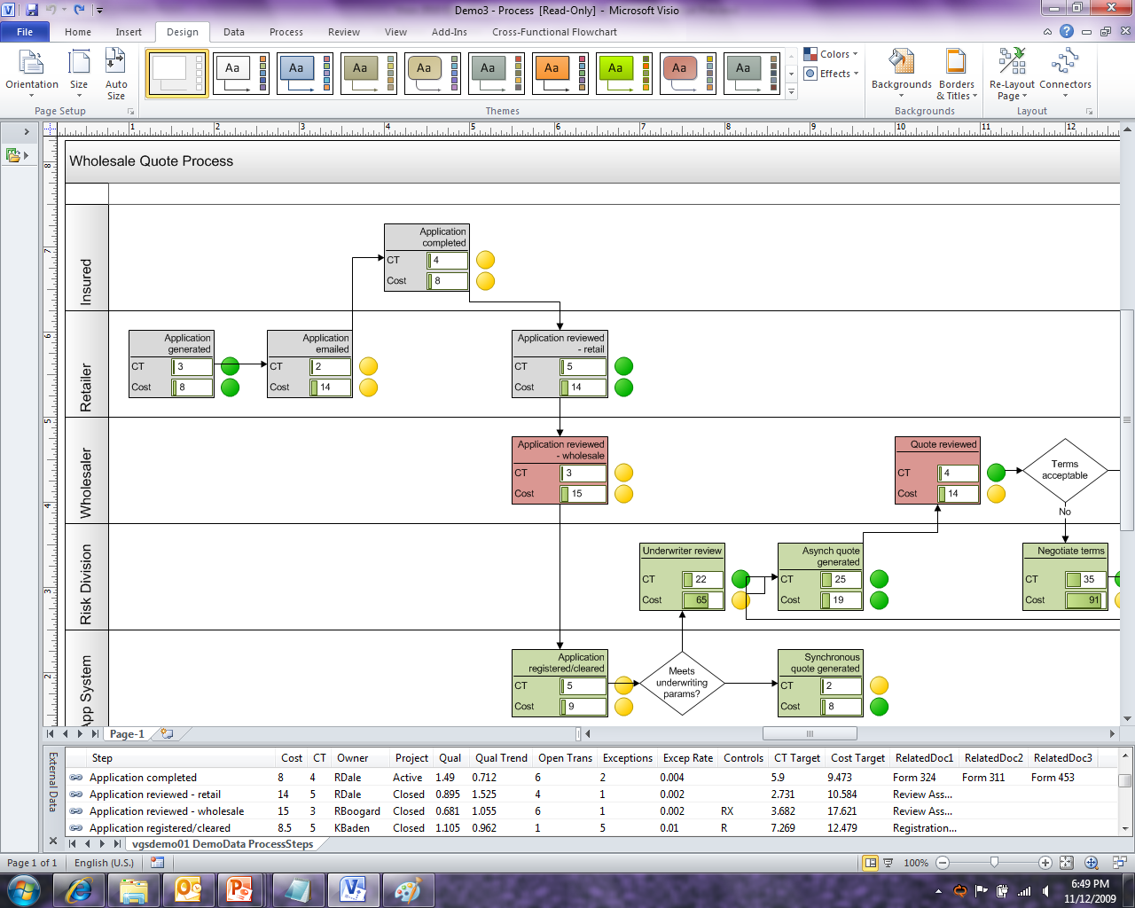
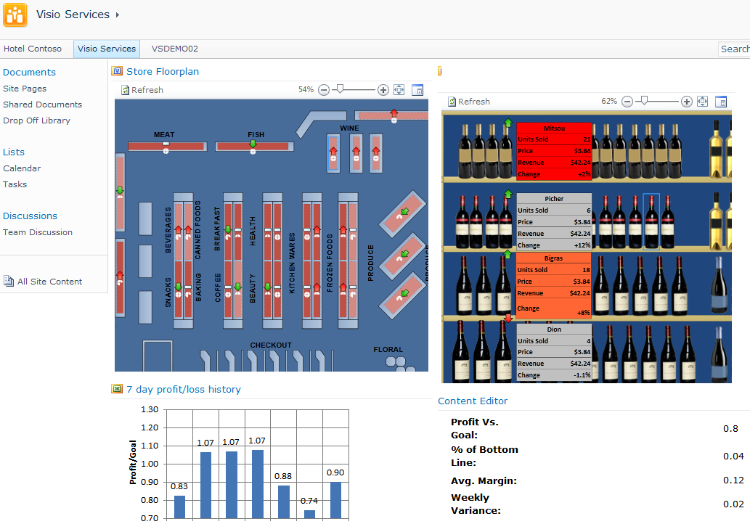
Customer Scenario – Visio services & BI
Visio allows data connectivity to multiple data sources and provides valuable business insights
Level 1: Visio diagrams can be connected to data sources
Putting data on diagrams makes the information meaningful and helps in identifying trends and exceptions at a glance
Level 2: Visio 2010 allows data-driven diagrams to be published to SharePoint Server 2010 in real time*
*New feature in Visio 2010
Notes:
BI can help you…
Identify cost cutting opportunities
Improve financial visibility
Manage operational improvement
Strengthen your customer base
And identify new sources of revenue
With Visio you can link diagrams to performance data to identify trends and exceptions. By showing information in context, Visio can make business data more meaningful and help you identify trends and exceptions at a glance to make better, faster business decisions.

Slide 7
Next Steps

Slide 8

Additional Resources
The Microsoft Visio web site http://visio.microsoft.com
Tips and Techniques L.L.C. web site http://www.tipsandtechniquesnow.com
http://tipsandtechniques.myvbookstore.com
Matthewr@tipsandtechniquesnow.com

Slide 9

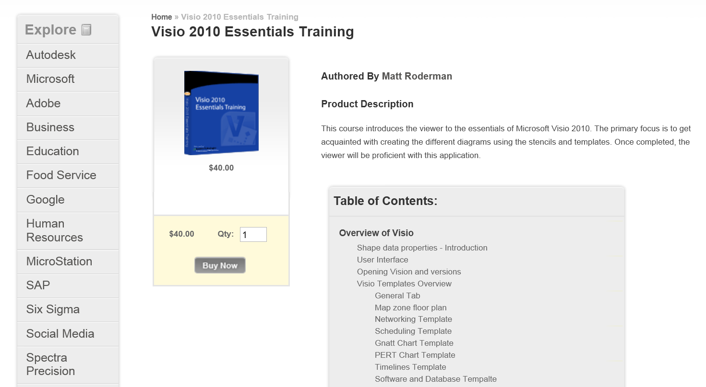
Use this Promotion Code T&T2012 and receive a 10% Discount

Slide 10

© 2009 Microsoft Corporation. All rights reserved. Microsoft, Windows, Windows Vista and other product names are or may be registered trademarks and/or trademarks in the U.S. and/or other countries.
The information herein is for informational purposes only and represents the current view of Microsoft Corporation as of the date of this presentation. Because Microsoft must respond to changing market conditions, it should not be interpreted to be a commitment on the part of Microsoft, and Microsoft cannot guarantee the accuracy of any information provided after the date of this presentation.
MICROSOFT MAKES NO WARRANTIES, EXPRESS, IMPLIED OR STATUTORY, AS TO THE INFORMATION IN THIS PRESENTATION.

